Slide 1

MSDN Developer Roadshow
July 7, 2003

Slide 2

Web Services -- Linking, the old, the new, and the future
Wayne Beekman
Information Concepts

Slide 3
Housekeeping
Restrooms
Lunch
.NET Solutions Pavilion
Ask-the-Experts
Raffles
Notes:
Restrooms – Located on Concourse and 2nd Floor.
Lunch – Served on 2nd Floor from 11:45-12:30.
.NET Solutions Pavilion – Please check out the Partner / User Group Pavilion on the 2nd floor to find out more about local Microsoft-focused Partners and User Groups.
Ask-the-Experts – Please stop by the Microsoft table or any of our partner tables throughout the day to ask the experts any questions you may have.
Raffles – We will be raffling away various prizes to individuals who complete and turn in session evaluations.

Slide 4
.Net In Action
Agenda:
  Definition of .net
  Discussion XML-Based Web Services – SOAP
  Mobility
  Case Studies
  How VS.Net increases development Productivity
  Demonstration of .net and Web Services

Slide 5
Information Concepts and .net
20 year old Custom Development Shop
Fixed Price Projects
Adopted .net for all new Microsoft development in 2002
Migrated Common services for validation and security.
Increased productivity from Planning through Deployment

Slide 6
Before Web Services
Watch Out for the Arrows
Microsoft
BEA
IBM
Oracle

Slide 7
With Web Services
Working Together
Microsoft
BEA
Web
Services
IBM
Oracle

Slide 8
Agility
Past 20 Years
  Built Systems to Last
Next 10 Years
  Build Systems for Change

Slide 9




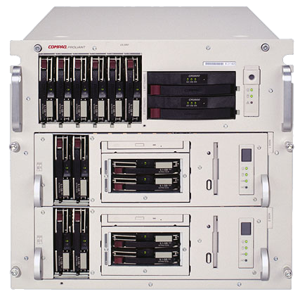




The Goal -- The Agile Company
Customer
Systems
Core Product
Product 1
Product 2
Accounts
Product 3
Notes:
Key Points:
The business “virtual” dynamic of relationships and dependencies is now the IT dynamic
Critical connections between people, partners, and customers now rely on technology
Business demand is scaling past system integration to “everything connected”
Detail:
Business is a virtual dynamic, of people, groups, partners, and customers. Success is based on the ability to master and maximize the communication, and information flow in and amongst all of the players – critical connections that now rely on technology.
Build 1:
Connecting internal systems is an existing and high priority for nearly every company, and has been for years. The exponential value in unlocking decision data, optimizing processes, and fueling new business has made this one of the largest areas of corporate investment – that will only continue.
Build 2:
The needs are also rapidly expanding beyond the firewall to connect remote offices or subsidiaries, mobile employees, and new devices for accessing and using corporate resources.
Build 3:
Perhaps more profoundly, connecting internal systems with those of external systems – partners, and customers. These relationships are central to the business, and with IT at the center of business, these connections must be a central capability of the technology.
Here the connections present not only greater opportunity, but also greater complexity. These external systems are not under your control – the potential variety of platforms, access points, data formats broadens rapidly.
Transition:
For most companies the value chain is far greater than the one relationship you see here…

Slide 10
Definition of .Net
.Net is Not:
  A Product
.Net is:
  An implementation of XML-Based Web Service
  SOAP – Simple Object Access Protocol

Slide 11
Microsoft’s Goal for .Net
  The Best Toolkit for Developing Web Services
  Visual Studio.net
  The Best Platform for Executing Web Services
  Windows 2003 / .net framework
  A Brand representing a Low Cost, High Value, End-to-End Platform

Slide 12




End to End Communications
Email
Web
Web Services

Slide 13
Web Services Definition
A protocol (SOAP) to exchange data between processes which is:
  Platform Independent
  Presentation Independent
  Standards Based (XML, HTTP)
  Self Descriptive (WSDL)
  Self Identifying (UDDI)

Slide 14

WS-I.ORG
Open industry effort chartered to promote Web Services interoperability across platforms, applications, and programming languages.

Slide 15
Industry Claims
Gartner Group (2002) claims that “2003 is the year for even cautious enterprises to begin Web services pilots.”
Merrill Lynch CTO
Infoweek Article – Web Services make the Platform Choices less arduous

Slide 16
Without Interoperability
Every Organization had its own standards
Could not exchange services between boundaries
Trade is Difficult

Slide 17
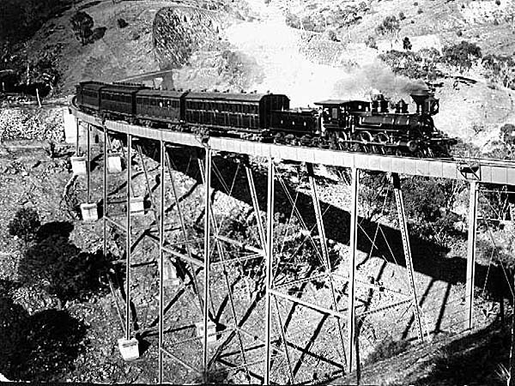

Trains
In the 19th century, every state had its own railroad gauge.
Gauge variation caused problem – long distance passengers, cargo, trade and services.
‘Standard gauge’ set to 1435mm.
Adhering to this standard has created – single train to go from east to west coast.
True interoperability.

Slide 18
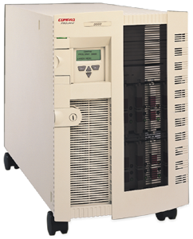

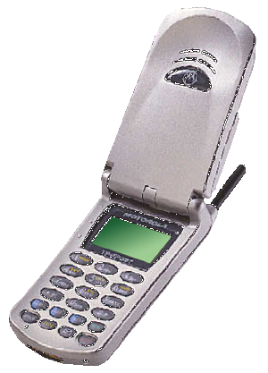
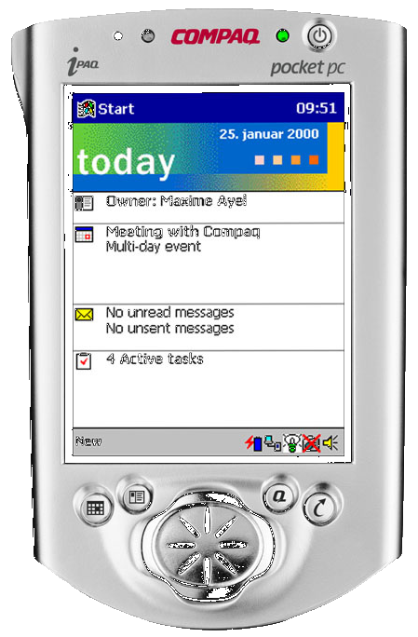
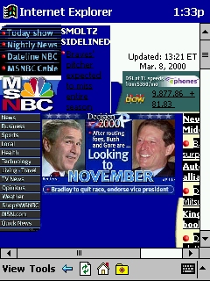
XML Web Services
“The Best Platform Wins”
LOB J2EE App
BEA Weblogic
Oracle 8i
Sun UE 10000
SAP R/3
DB2
Solaris
IBM RS/6000
Language Independent
Platform Independent
Device Independent
Inside and Out
Motorola i85s
J2ME
XML Web Services
Compaq iPAQ
Windows CE
StrongARM
PERL
Apache 2.0
MySQL
Linux
PeopleSoft 7.0
SQL 2000
Windows 2000
Compaq Proliant

Slide 19
Traditional Legacy Architecture
User Interface
Business Logic and Data Access
Web
Client
Server
3270
Word
Proprietary
Help
Desk
Time
Sheet
Contracts
Policies
Contacts

Slide 20
Using Web Services
User Interface
Business Logic and Data Access
External Computer Processes
Mobile Applications
Web
Smart
Client
Office
Web
Service
Web
Service
Web
Service
Web
Service
Web
Service
Help
Desk
Time
Sheet
Contracts
Policies
Contacts

Slide 21
A Web Service
Call the Web Service (Consume)
WSDL File
Created by VS.Net and Accessed via Web
Web Service Wrapper -- Function Call
Business Logic

Slide 22
WSDL
WSDL is an XML format for describing network services as a set of endpoints operating on messages containing either document-oriented or procedure-oriented information.
WSDL is Machine Generated and Machine Read by VS.NET or other web service toolkits
Defines Where to go, How to Use, and What will Happen
Sample WSDL

Slide 23
UDDI
Built Into Windows 2003 Server
Yellow Pages for Web Services
Design Time Binding
  Look up the Web services interfaces of your business partners and potential partners.
  Discover technical details on working with other Web services, and post details.

Slide 24
Mobile Applications
By 2005, 40 percent of mobile workers in North America will regularly use:
  Wireless LAN (WLAN)
  General Packet Radio (GPRS)
  Single Carrier Radio (1xRTT)
4 out of 5 projects will underestimate the TCO by 30%
25% of vertical mobile Application deployments in 2003 will succeed, Failures due to:
  Social Factors
  Poor Architectural Choices
  Enterprises must Plan for 5 Categories of Mobile Workers

Slide 25




Types of Mobile Workers
Message
Email centric
Offline
Forms
Well Defined
Cached
Slim Client
Knowledge
Unstructured Messages
Smart Client
Power
Full-Fidelity
Thick Client
Alerts
Thin Client
Read, One Button Response

Slide 26
Web Services and Mobility
Web
Service
Web
Service
Web
Service
Dispatch
Orders
HR

Slide 27



.NET Evolution
Application
Code and
data structures
Before COM, applications were completely separate entities with little or no integration

Slide 28

.NET Evolution
COM provides a way for components to integrate. However, each component must provide the “plumbing” and objects cannot directly interact.

Slide 29



.NET Evolution
With the .NET Framework common language runtime, components are built on a common substrate. No “plumbing” is needed and objects can directly interact

Slide 30
.net Framework Benefits
Web forms
Windows Forms
Offline Windows Applications
No-Touch Deployment of Smart Clients
How do we get it deployed (26MB)

Slide 31
.Net in Action – Case Studies
Integration with Legacy Systems
Web Based Access
Offline Access
Synchronize Offline Data when Online
Fixed Price Development

Slide 32
Association Accreditation System
Accreditation Process is complex
Many Different groups involved
Accreditation can take a year
High stakes transaction
Volunteers used for Review
Need Offline Processing
Needed to Collect Metrics from Data

Slide 33




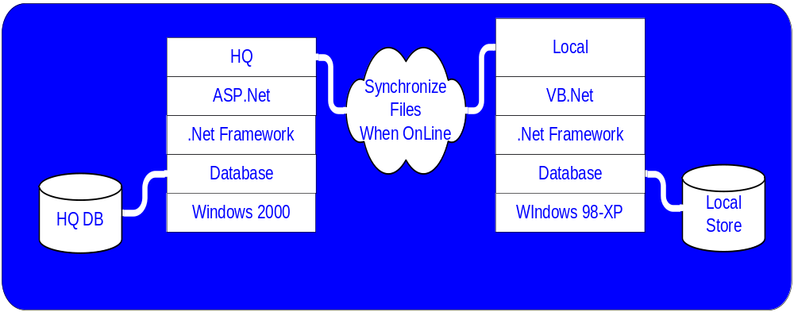


Accreditation - Offline Process
Web Based System
Forms

Slide 34
Solution
Complete process automated
System tracks process
Metrics collected
Nagging Subsystem
Offline Processing Allows Reviewers to work from the road
Reduce Accreditation time by months

Slide 35
Financial Management
Each Local Office maintained independent Books
Auditors needed to fly out to visit locations
Needed Standard Data collection among offices
Government Financial Reports needed to be files correctly

Slide 36
System Migration – Financial Management
Auditors
MS
Office
Locals
Quicken
98
Quicken
2001
Quicken
2000
Quickbooks
2001
Quickbooks
99
Web Services
Legacy
Applications
Quickbooks
Quicken
2000
Oracle
Quickbooks
2002
SQL Server
Quickbooks
99

Slide 37
Solution
Web Access for 1,300 Locals
Auditors could work from HQ
Quicken/QuickBooks Replacement
Integrates with ADP Payroll
Office Integration for Letters and Spreadsheets

Slide 38
Case Study Summary
Smart Client User Interfaces
  Offline Processing
  No Touch Deployment
Web Services Architecture Provide a future foundation for development
Developed on-time and on a fixed price

Slide 39
How .Net increases development Productivity
Planning
Development
Testing
Deployment

Slide 40
Planning
Prototype using VS.net – No Need to Front Page Mock Ups
Drag and Drop User Interface development
Build using the same templates
Component re-use is part of the project definition
Database modeling - Create conceptual, logical and physical diagrams to capture business requirements.

Slide 41
Development
No need to Rip/Replace – use web services to integrate
Use of Web Services allows for platform-independent transactions
Web services provides a common dialogue with legacy teams
Custom templates that can be used by developers in a team environment.
ASP.NET Controls - run on server, push user interface as html to browser

Slide 42
Testing
Single Debugging environment
Step through Code
ACT provides Stress / Load testing
No Need for third Party Licenses

Slide 43
Deployment
No-Touch Deployment on Desktops
Provide users with rich user interfaces without the need for complex installations
XCOPY deployment - no need to register dll
ASP.net - runtime compiled. Allows better memory management

Slide 44
Benefits of .net Development
Summary
Speed up development
Encourage code reuse
Help us to write bug-free code

Slide 45
Demo
User Interface
Business Logic and Data Access
Web
Smart
Client
Excel
Nokia
Web
Service
Get
Author

Slide 46

© 2003 Microsoft Corporation. All rights reserved.

